Slide 1

Spa System RUTLAND
Project Group Number (in Blackboard): CS321 Project Group 3
Section Number: L4F4

Slide 2
Hello!
We are
Noran Abo Shaib
Tasneem Hamdy Dosoqi
Rahaf Saleh Alzahrani
Areej Awad Aljuied

Slide 3
Description :
Our Beauty Spa system provides a lot of Spa services, it serves manager, employee and customer. It helps the manager to control the employee and the Spa services. Employee helps the customer to reserve the services. Customer can use the system to use the available services.

Slide 4
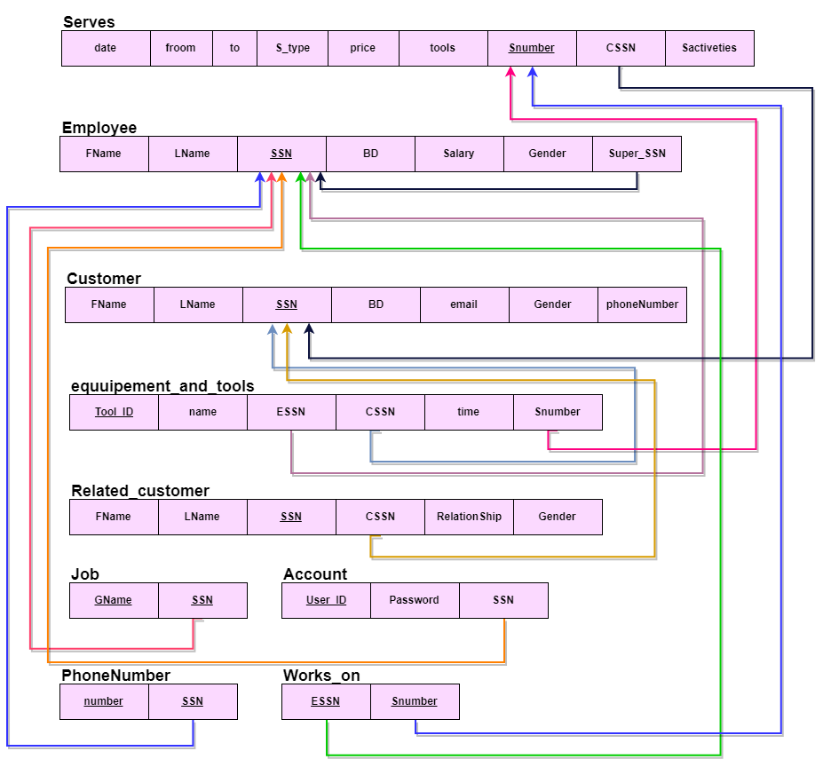
Description :

Slide 5
DIFFICULTIES AND HOW PROBLEMS WERE SOLVED:
The number of lines makes us take too long time to finds the errors.
We did not hade enough time in college to gather and complete the project together, and working spritely in home make it more harder.
Error was more in GUI part we was having AWT errors even that we did not use any awt component!
Moving project to other device s was making errors!

Slide 6
Thanks!
Any questions?
Noran Abo Shaib (Leader) 2160007937
Tasneem Hamdy Dosoqi 2160007430
Rahaf Saleh Alzahrani 2160006662
Areej Awad Aljuied 2150007201

